Slide 1

SPC-3DGS
3D SCENE RECONSTRUCTION WITH SINGLE PHOTON CAMERAS & GAUSSIAN SPLATTING
EE21B144: Sujal Burad
MM21B044: Nikshay Jain
EE5176: COMPUTATIONAL PHOTOGRAPHY

Slide 2

Tasks
Reproduce PhotonSplat baseline using SPC binary frames and binary cross-entropy loss.
1
Develop trajectory-aware accumulation (blur modeling, exposure loss functions), inspired by BAD-Gaussians.
2
3
Remove reliance on COLMAP by jointly optimizing camera poses & Gaussian parameters to obtain Prototype operating solely on SPC frames.

Slide 3
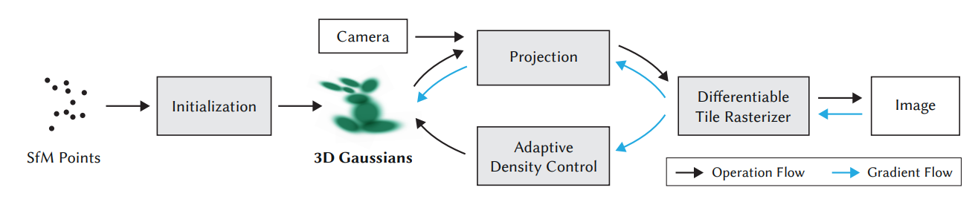
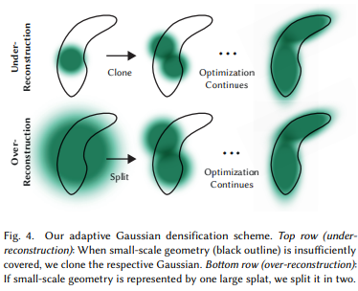
3D Gaussian Splatting (SIGGRAPH 2023)
Millions of 3D Gaussians—explicit, differentiable, adaptive.
Dynamic density control: clone, split, prune for detail.
Fast GPU rasterization: Real-time, high-quality results.
Benchmark results: Outperforming NeRF in quality & speed.
5
Notes:
3D Gaussian Splatting is a breakthrough in radiance field rendering. Instead of neural networks, it uses explicit scene modeling—millions of 3D Gaussians, each representing a part of the scene.
These Gaussians are managed adaptively, enabling real-time rendering and much faster results than neural field methods, with improvements in both speed and quality.

Slide 4
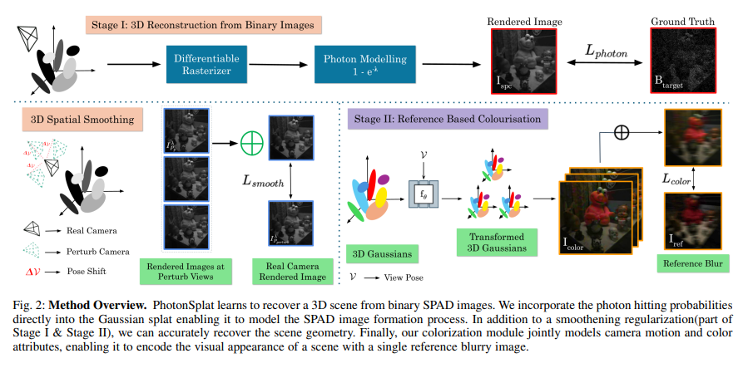
PhotonSplat (ICCP 2025)
Direct modeling of photon arrivals with binary cross-entropy loss.
3D Gaussian Splat representation for scene geometry.
Spatial consistency regularization: reduces overfit to noisy input.
Colorization: recovers color even from blurry ref images.
5
Notes:
PhotonSplat, our key baseline, models how photons arrive physically at a sensor.
It natively supports binary SPAD data and uses view-consistency regularization for robustness to noise.
A novel aspect: it can perform colorization using just a blurry reference image, so even in tough conditions, reconstructions remain meaningful.

Slide 5
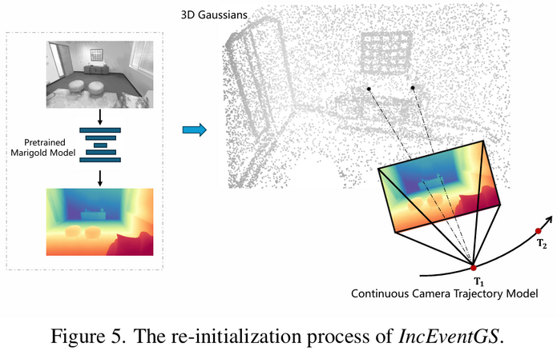
IncEventGS
Novel 3D reconstruction method using only event cameras, without requiring ground-truth poses.
Combines tracking & mapping in a SLAM-like pipeline to refine both scene representation & camera motion.
Outperforms NeRF-based & event-visual odometry methods in both novel view synthesis and motion estimation.
Demonstrates robustness in challenging scenarios like fast motion and low light, highlighting event cameras’ advantages.
5
Notes:
PhotonSplat, our key baseline, models how photons arrive physically at a sensor.
It natively supports binary SPAD data and uses view-consistency regularization for robustness to noise.
A novel aspect: it can perform colorization using just a blurry reference image, so even in tough conditions, reconstructions remain meaningful.

Slide 6
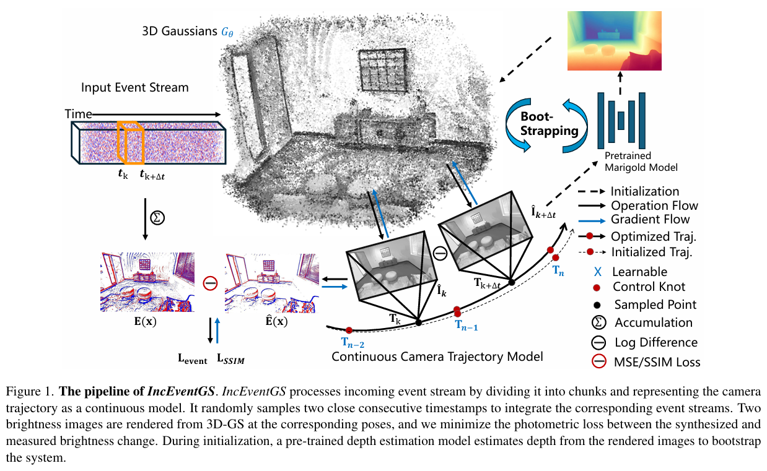
(Framework built for event-camera dataset)
IncEventGS Pipeline
5
Notes:
PhotonSplat, our key baseline, models how photons arrive physically at a sensor.
It natively supports binary SPAD data and uses view-consistency regularization for robustness to noise.
A novel aspect: it can perform colorization using just a blurry reference image, so even in tough conditions, reconstructions remain meaningful.

Slide 7
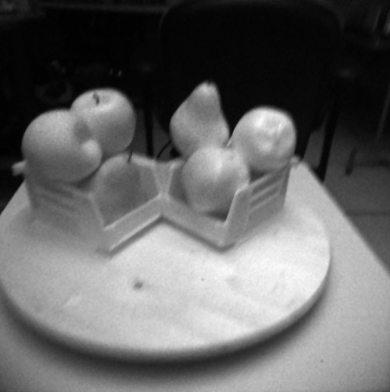
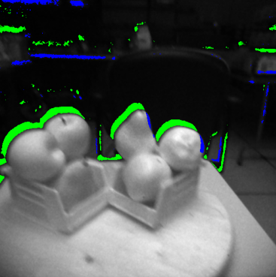
Data preparation
(Converting PhotonSplat data to event camera data form)
1] 130 images are obtained using averaging, using a median filter, and normalizing the original PhotonSplat data
2] 130 grayscale images are converted to the the event-camera data form, by using Event-Simulator
First 10k events visualisation

Slide 8
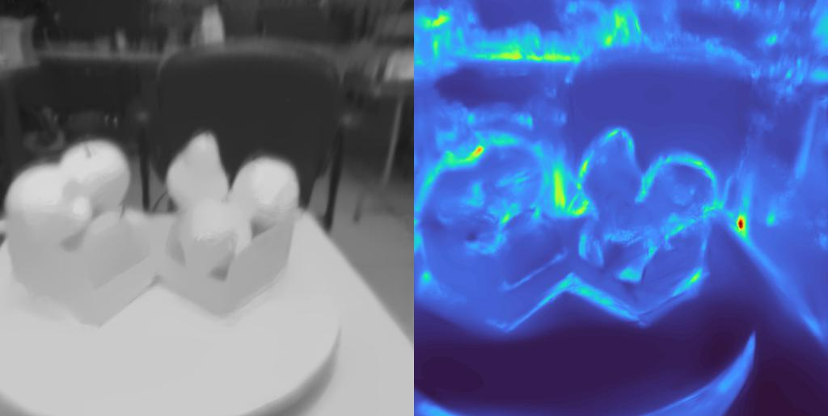
Initialization
Left = Rendered image from current 3DGS model as seen by estimated camera poses
RIght = Corresponding depth colormap visualisation

Slide 9
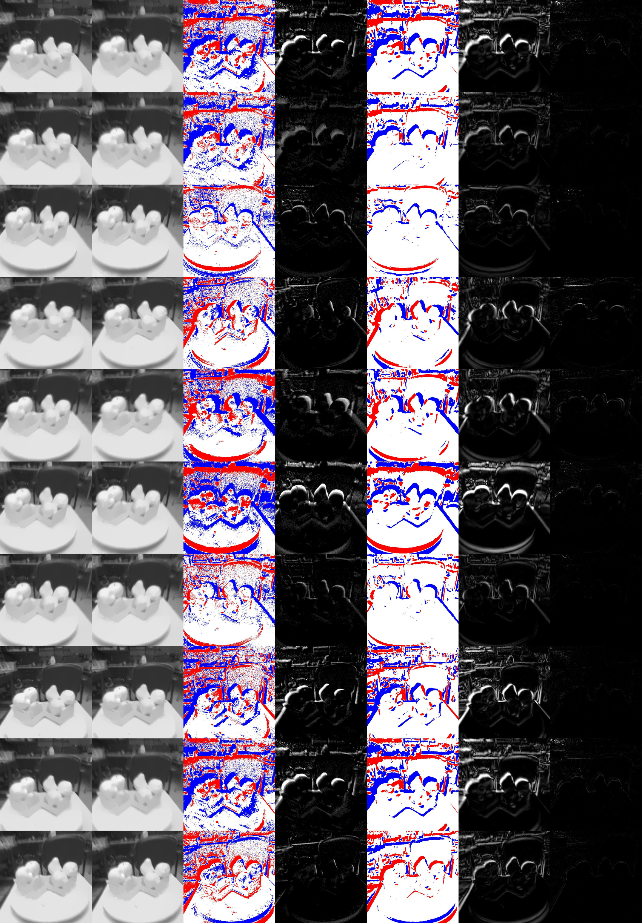
Visualizing intermediate images during initialization
Event chunk start image
Event chunk end image
Ground truth event accumulation
Ground truth event accumulation, in grayscale
Predicted event accumulation, after thresholding
Predicted event accumulation, after thresholding, in grayscale
Difference between ground-truth and predicted event accumulation

Slide 10
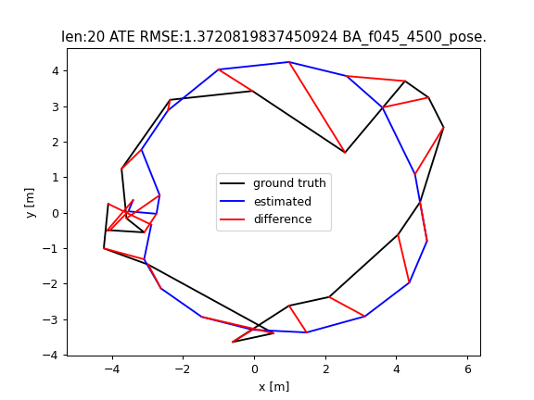
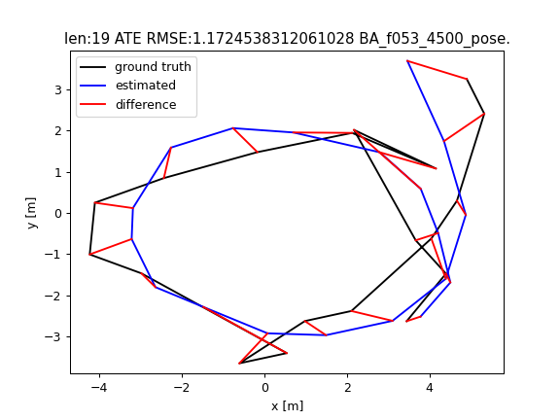
Bundle adjustment trajectory
Demonstrates that our implementation is capable of capturing complex camera pose trajectories.

Slide 11
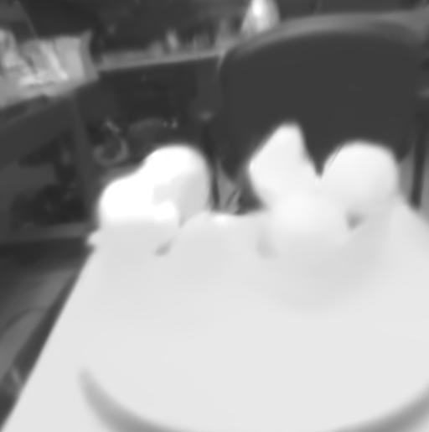
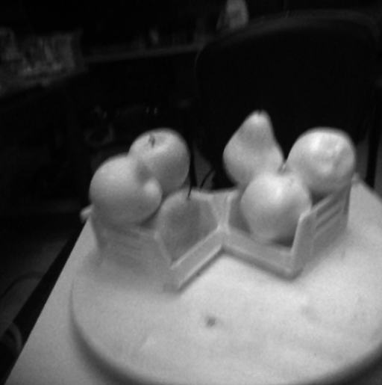
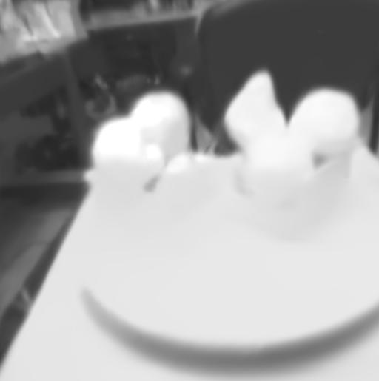
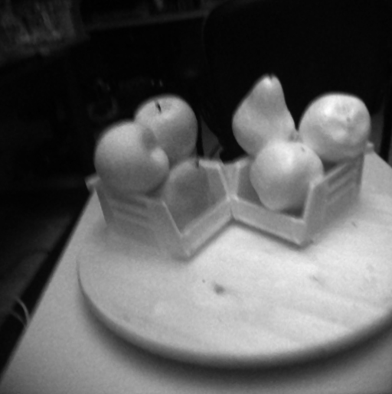

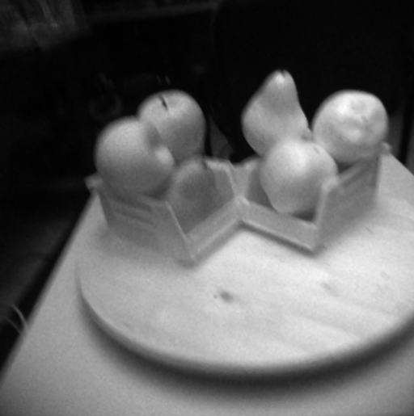
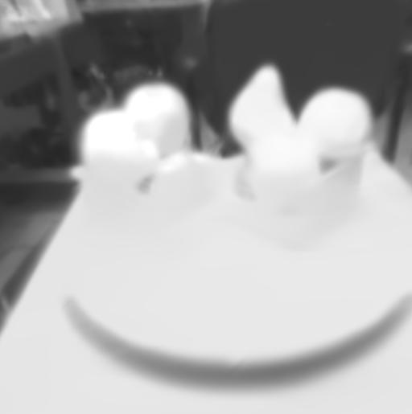
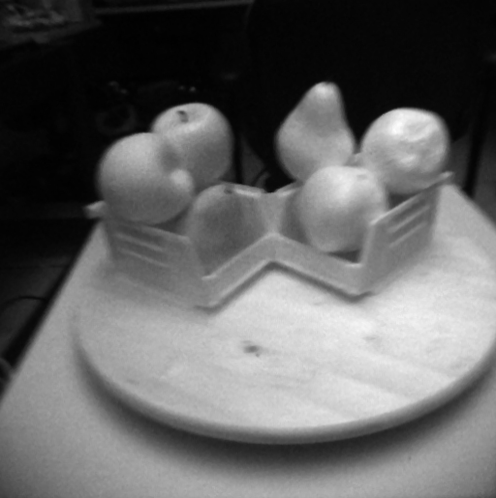
Validation
Rendered image
Expected Output
Rendered image
Expected Output

Slide 12
Implementation Overview
Data Conversion: PhotonSplat SPAD data transformed to event camera format using Event Simulator with custom contrast threshold
Pose-Free Reconstruction: IncEventGS pipeline successfully captures complex camera trajectories without COLMAP initialization
Limitations:
Render quality and estimated camera motion trajectory can still be improved
Addressing Limitations
Hyperparameter tuning and contrast threshold optimization are required to improve reconstruction quality

Slide 13
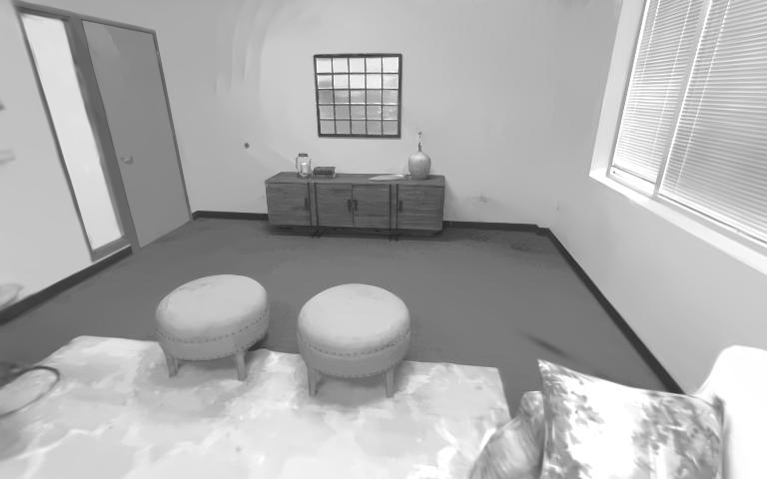
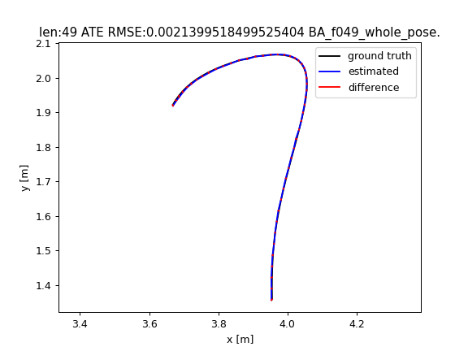
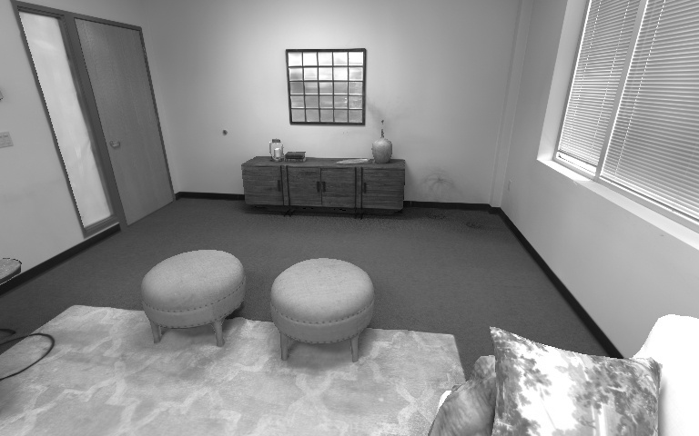
Validation examples for event replica_room0 data
Estimated
Ground truth

Slide 14
References
PhotonSplat - https://arxiv.org/pdf/2506.21680
3D GS - https://arxiv.org/pdf/2308.04079
IncEvent GS - https://arxiv.org/abs/2410.08107
Event Simulator - https://arxiv.org/abs/1912.03095
Thank You !

